Slide 1
C2P India
QA Track
Interchange Loader, Walkthrough's & Exercise

Slide 2
Agenda
Loader
Question and Answers
Walkthrough's
Exercise

Slide 3
Agenda
Loader
Question and Answers
Walkthrough’s
Exercise

Slide 4

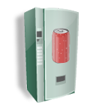
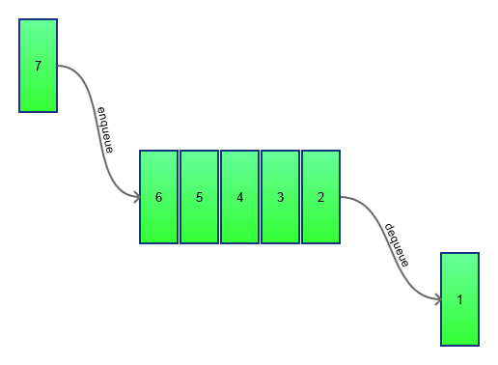

Interchange Loader
New payment File
New payment File
TVA
System Queue
Interchange
Loader
A new file from a payment gateway comes into the system.
TVA, being a driver, puts the message onto a System Queue. Messages are received from one or more queues that the host bank uses to receive payments messages from different Participants.
First Service that keeps listening for the payment message is interchange Loader.

Slide 5
Interchange Loader
Interchange Loader Service :-
Loads an Payment Interchange message from a queue.
Verify that the message file Block 1 contains a Bank Name, matching a Bank stored in the system.
Store the payment as an Interchange record in the system. i.e. the payment can Interchange can now be seen in BVA. No matter what validation failure happens next.
The IC Load service then places the Interchange message onto the Parsing Service queue.

Slide 6
Agenda
Loader
Question and Answers
Walkthrough's
Exercise

Slide 7
Interchange Loader – Walkthrough's
Walkthrough's
Use Case walkthrough - XCT_ICLOAD_BS_UC001 – Load and Store an Interchange.
Sample Test Case Walkthrough for the above use case.
Upload Sample Test Data File and validate in DB & BVA.
(Note – Please change date to ‘current date’ before use)

Slide 8
Agenda
Loader
Question and Answers
Walkthrough's
Exercise

Slide 9
Interchange Loader – Exercise 1
Exercise 1
A Jira prep/exe task would be assigned to each of participant in this room.
Write all the possible test cases for all the flows for Use Case (XCT_ICLOAD_BS_UC001 – Load and Store an Interchange) while making sure you follow the test case writing checklist. (Use Test Case writing Excel Template).
Update Jira status as per the Testing procedure and workflow explained in earlier individual sessions.
Once done with writing Test Cases, commit them in SVN.
Add the SVN location of Test cases in Jira and send the test cases for review.
Do a peer review for the test cases written by others (assigned to you).
Incorporate Review feedback received for your test cases and send it for BA Review. (available BA’s List would be provided).
Incorporate BA’s Feedback comments.
Note:- Make sure to follow all the process for Spira, Jira, TC checklist that have been discussed in previous sessions.

Slide 10
Interchange Loader – Exercise 2
Exercise 2
Upload the test cases on Spira.
Map the test cases with the requirements in Spira
Create a test Set and Map the test cases with it and mention the test set URL info on the QA EXE Jira task.
Start Executing the test cases using test set against a release in Spira.
Log the bugs in Jira while you execute the test cases and link them with the prep/Exe task with their proper dependency/relation with the task.
Update the Jira task status as per workflow.
Record results with execution screenshots wherever applicable (in .doc format).

Slide 11
Interchange Loader – Exercise 2
Exercise 2
Upload the test cases on Spira.
Map the test cases with the requirements in Spira
Create a test Set and Map the test cases with it and mention the test set URL info on the QA EXE Jira task.
Start Executing the test cases using test set against a release in Spira.
Log the bugs in Jira while you execute the test cases and link them with the prep/Exe task with their proper dependency/relation with the task.
Update the Jira task status as per workflow.
Record results with execution screenshots wherever applicable (in .doc format).

Slide 12
What you should Know after this?
What is Interchange Loader Service?
Understanding Message Entry/Loading into System.
Outcome of Interchange Loader Service Flow.
Test Process to validate Interchange has been successfully loaded in System.

Slide 13
Loader - Checklist
Understanding Loader service
Payment life cycle (From Payment Loader prospective)
Use case walkthrough.
Test case walkthrough.
Upload file & Check loaded Interchange in DB
Outcome of Loader service
Exercise

Slide 14

Question *A matter requiring resolution or discussion.
Open Your Mind
Widen Your Thoughts

Slide 15
Revision History
Date | Rev | Who | Description
 | 0.1 |  | Initial verison
22/12/2015 | 0.2 | Nitin Jain | Removed ‘referenced/supporting’ from Interchange Loader – Walkthrough's slide as these are not needed. Updated content from Exercise Day 1 & 2 to Exercise 1 &2. Update – with What you should Know after this? Slide - from “End to End Test Process followed in OPF Product or projects based of OPF.” to “Test Process to validate Interchange has been successfully loaded in System” Added Test data file.

Slide 16
EMEA – Headquarters
Brussels, Belgium
info@clear2pay.com
APAC
Sydney, Australia
info.apac@clear2pay.com
Americas
Atlanta, USA
info.americas@clear2pay.com
www.clear2pay.com

